Slide 1
Medical Information Management System
Denney Burkholder
Alexandra Garcia
Alyssa Kelley
Leonardo Reyes
Albert Wallace

Slide 2
Table of Contents
Concept Statement
Domain Analysis
Use Cases and Scenarios
Domain Class Model
Domain State Model
System Sequence Diagrams
Logging Into System
Making Departmental Requests
Adding New Patient
Accessing Patient Data
Application Analysis
Concrete Use Cases
Application Class Model
Application State Model
Consolidated Class Model
Summary

Slide 3
Concept Statement
Medical information management system (MIMS) is a database management system that provides the capabilities for a hospital, through its various departments, doctors, nurses, laboratory testers and management personnel to access patient records and provide services. MIMS keeps records of each patient in the form of an electronic chart, which contains the patient’s medical history as well as information on each visit to the hospital. Each visit may or may not have prescriptions associated with it. Each patient history record should include: medical history, medication and allergies, immunization status, and billing information. Records of each visit should include: updated vital signs, updated personal stats like age and weight, current visit reason (symptoms, concerns, etc.), laboratory test results, radiology images, prescriptions issued, and plan of care. The medical staff communicates electronically between departments from MIMS and views appropriate actions taken on their behalf. Each department has an electronic mailbox which each doctor must login to. For example, prescriptions generated in MIMS are instantly time-stamped and the pharmacy Pending Prescriptions receives a new message with issuing doctor information for dispensing. When the order is processed, the pharmacy computer system routes the information back to MIMS and the patient's electronic chart is updated. In this manner, MIMS provides seamless communication between health care providers and ancillary service areas across the network system.

Slide 4
Domain Analysis

Slide 5
Add Patient – new patient is added to the database
Check to see if patient currently exists
If patient doesn’t exist create a new patient record
Access Record – read or write to database
Search for patient
If not found return an error
If found return patient record
Request to other Departments – i.e. prescription, X-ray, and etc.
User submits a request to system
System looks for the department and sends request
Logging into System
User enters username and password
System checks with the database of usernames and passwords

Slide 6
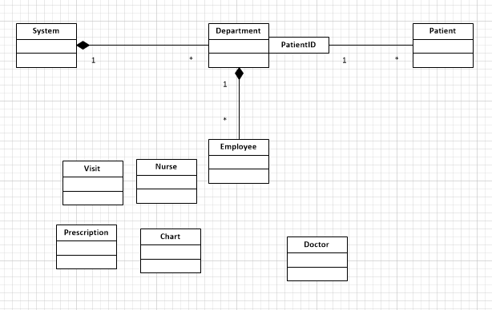
Domain Class Model

Slide 7
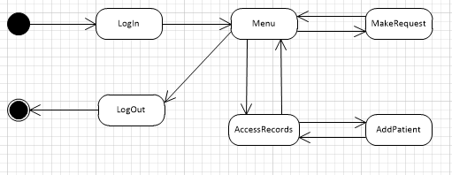
Domain State Model

Slide 8
System Sequence Diagrams

Slide 9
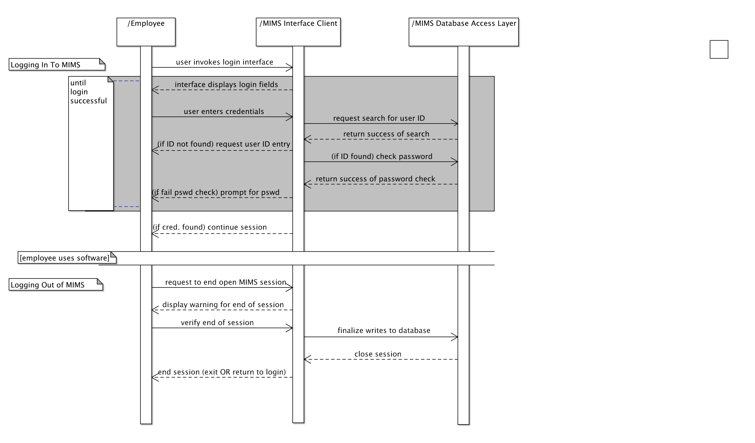

Slide 10
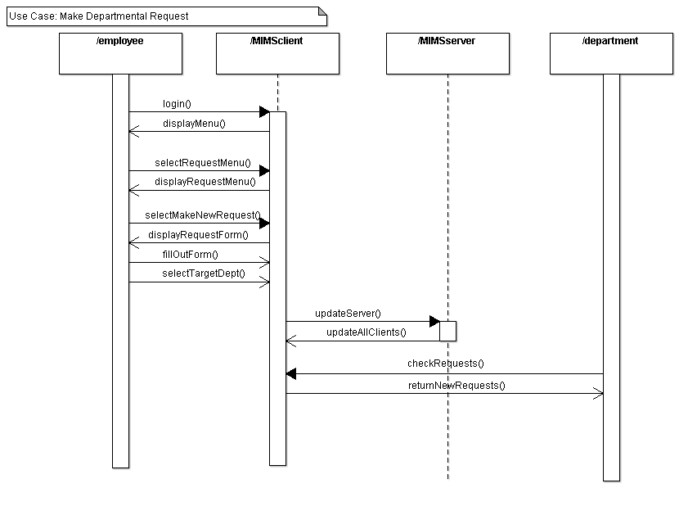
Departmental Requests

Slide 11
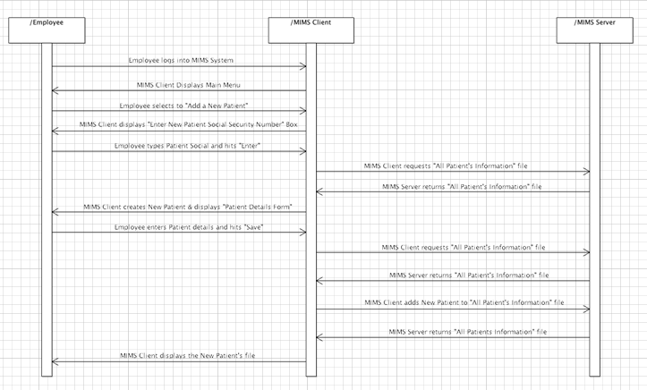
Adding New Patient

Slide 12
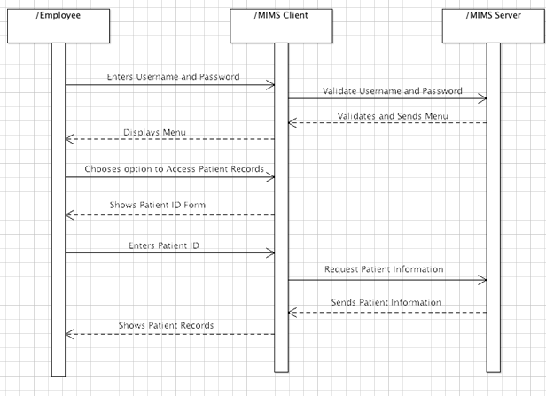
Accessing Patient Records

Slide 13
Application Analysis

Slide 14
Concrete Use Cases

Slide 15
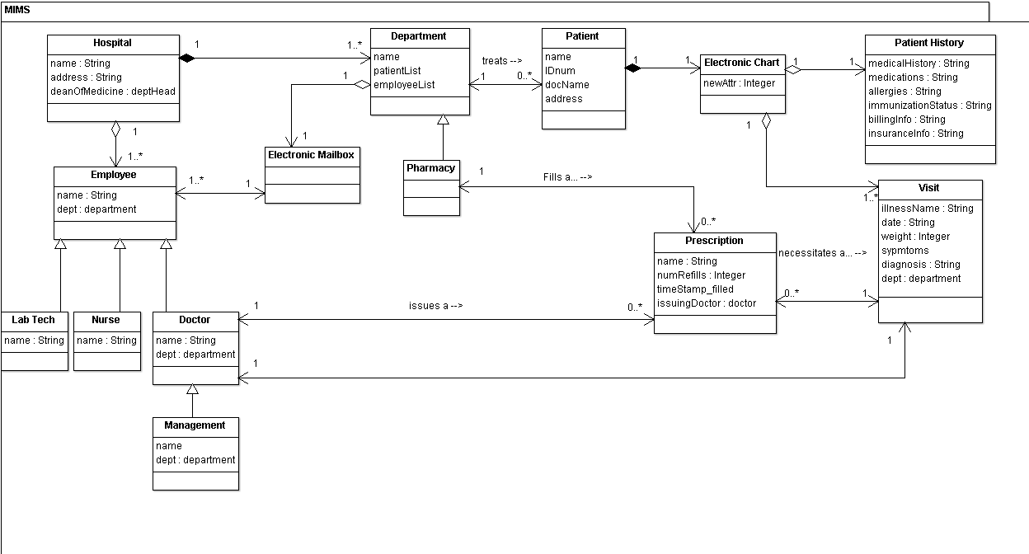
Application Class Model

Slide 16
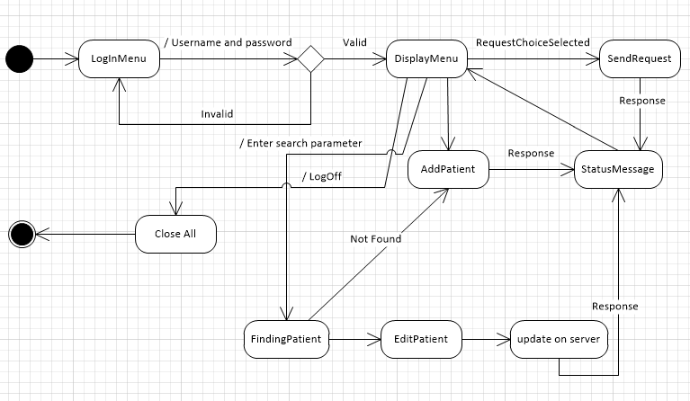
Application State Model

Slide 17
Consolidated Class Model

Slide 18
Summary

